Slide 1
KRATOS FOUNDATION
SOCIAL LISTENING: ANALYZING AND VISUALIZING SOCIAL NETWORKS
PROMOTING TRANSPARENCY AND FAIRNESS IN THE ELECTORAL PROCESS
PRESENTED BY: VIVIAN KING'ASIA

Slide 2
Company
Background
Kratos is a democracy focused NGO
that works with different stakeholders within a country to promote fair and transparent elections.

Slide 3

Our Common Ground
THE IGNORANCE OF ONE VOTER IN A DEMOCRACY IMPAIRS THE SECURITY OF ALL.
JOHN F. KENNEDY

Slide 4
Objectives
To perform a network analysis on the MAMAMBOGA hashtag on Twitter using Gephi to determine:
Who are the most important and influential players in this Twitter network?
What role do these key players play in spreading and sharing propaganda?
Identify trendjackers in the network.

Slide 5
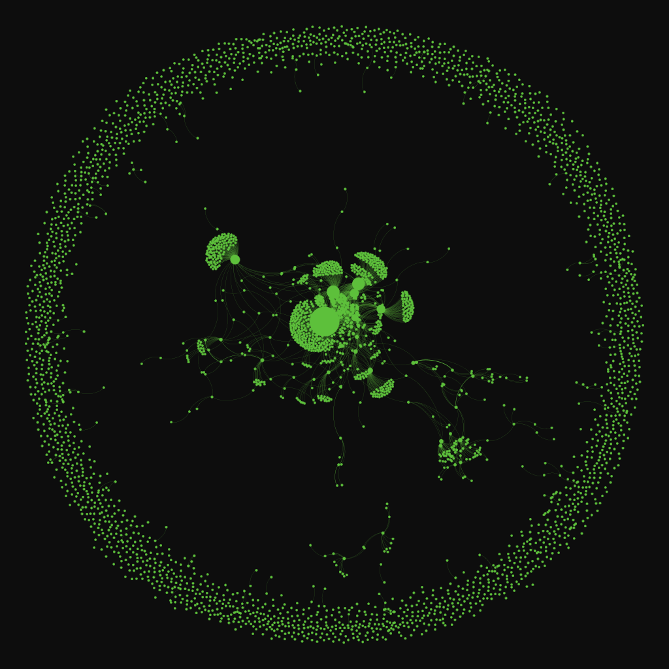
Most Important Nodes
Using weighted degree ranking, that measures the most important nodes, most influential nodes were identified through size.

Slide 6
When the graph is zoomed in,(next slide), six important nodes are identified based on the size of the nodes, as key players in the network.
@williamsruto (largest node)
@williamsruto, @railaodinga, @citizentvkenya
@williamsruto, @railaodinga
@OleItumbi
@NyoroNdindi
@WanjikuHSC

Slide 7
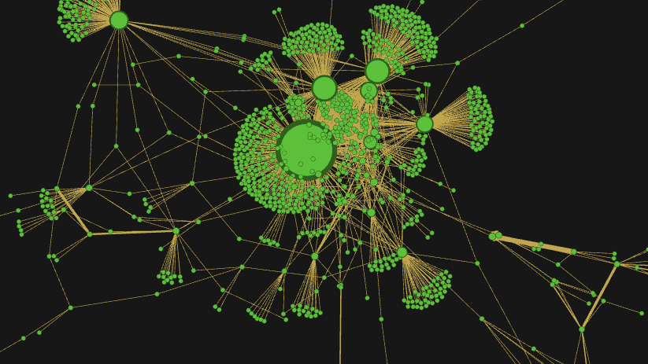

Slide 8
14.51%
PERCENTAGE OF WILLIAM RUTO TWITTER MENTIONS UNDER THE MAMAMBOGA HASHTAG.
THE MAJORITY OF THESE TWEETS WERE DUPLICATED TWEETS IMPLYING PAID INFLUENCERS TO PUSH A NARRATIVE IN FAVOR OF RUTO.

Slide 9
5.65%
5.5%
PERCENTAGE OF WILLIAM RUTO, RAILA ODINGA, AND CITIZEN TV MENTIONS UNDER THE MAMAMBOGA HASHTAG.
THE MAJORITY OF THESE TWEETS WERE DUPLICATED TWEETS IMPLYING PAID INFLUENCERS TO PUSH A NARRATIVE.
PERCENTAGE OF WILLIAM RUTO AND RAILA ODINGA MENTIONS UNDER THE MAMAMBOGA HASHTAG.
THE MAJORITY OF THESE TWEETS WERE DUPLICATED TWEETS IMPLYING PAID INFLUENCERS TO PUSH A NARRATIVE.

Slide 10
THE ROLE OF IMPORTANT NODES IN SPREADING PROPAGANDA
@OLEITUMBI
@NYORONDINDI
@WANJIKUHSC
Dennis Itumbi
Public Comms & Digital Strategist and journalist.
Account verified
William Ruto Supporter
Spreading propaganda through fake news.
Served as a source for the spread of hustler ideology through the hashtag #mamamboga.
Impact average-90.55
Reach- 381,022
Most influential based on node size.
Ndindi Nyoro
Kiharu MP and Entrepreneur. Published Author.
Account not verified
William Ruto Supporter
Spreading propaganda through fake news about the opposition leaders.
Served as a source for the spread of negative ideology through the hashtag #BabaNaMama.
Impact-97.7
Reach- 1,186,717
Karen Wanjiku
Influencer.
Account not verified
William Ruto Supporter
Spreading propaganda through fake news about the opposition.
Served as a source for the spread of hustler ideology through the hashtag #MamaMbogaMoment
Impact-93.1
Reach- 342,394
Least influential based on node size.

Slide 11
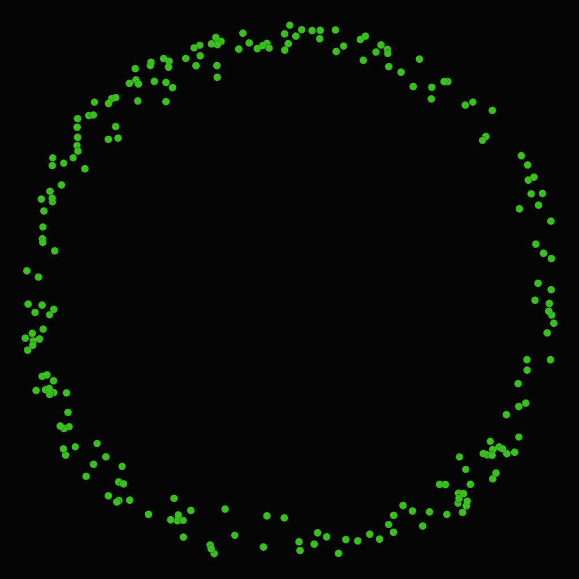
TRENDJACKERS
Trendjackers were identified by filtering the network using impact range, reach, twitter following and the hashtag used.

Slide 12
IDENTIFYING TRENDJACKERS
IMPACT/REACH/FOLLOWERS
HASHTAGS FILTERED
EXAMPLES OF TRENDJACKERS
Filtered based on a reach between 0-2500.
Filtered based on an impact of between 0-15.
Filtered based on followers between 0-7000
Some of the hashtags filtered include:
#mirema, #bwaffair, #mamambogamoment
#mamambogamoment, #masculinitysaturday
#healthinsurance, #mamambogamoment, #inawezekana
@Its_____Anne
@samie_luizy
@IkoKaziKE_Bot
@kimkendrickim
@BCherich

Slide 13
Although the 3 largest nodes belonged to William Ruto, Raila Odinga and CitizenTV, these accounts were not the authors but rather used as mentions in tweets and retweets.
Most of these tweets and retweets included the same or similar messages forwarded by different authors.
Trendjackers comprised of a huge number of the tweets and retweets, inflating the number of tweets under the mamamboga hashtag.
There were presence of bots, but most of them identified were in the role of trendjacking.
Conclusion

Slide 14
MOST IMPORTANT NODES GRAPH
File:///C:/Gephi%20visualization%20files/case%20study%202/Importantnodes.svg
TRENDJACKERS GRAPH
file:///C:/Gephi%20visualization%20files/case%20study%202/trendjerkers.svg
Links

